Slide 1
A Presentation on “Component Based Software Engineering (CBSE)”
Presented by:
MSc.CSIT 1st Semester (Group A)
Anita Joshi, Krishna Prasad Acharya, Rahul Poudel, Rajesh Acharya, Rajesh Shahi, Shailesh Acharya

Slide 2
What is Component?
A component is a modular, portable, replaceable, and reusable set of well-defined functionality that encapsulates its implementation and exporting it as a higher-level interface.
A software component can be deployed independently and is subject to composition by third-parties.
Components are more abstract than object classes and can be stand-alone service providers.
Components provide a service without regard to where the component is executing or its programming language.

Slide 3
Component Based Software Engineering
In CBSE we develop software using already available components.
In this kind of development there is no concept of building any software from the scratch.
Components communicate with each other by there well define Interfaces.
It provides a higher level of abstraction and divides the problem into sub-problems, each associated with component partitions.

Slide 4
Properties of CBSE
Independent
Standardized
Deployable
Documented

Slide 5
Benefit of CBSE
Reusability
Extensibility
Maintainability

Slide 6
Component Interfaces
Interfaces describe what a component may
Offer : provides interface
Needs : requires interface
Provides interface
Defines the services that are provided by the component to other components.
This interface, essentially, is the component API. It defines the methods that can be called by a user of the component.
Requires interface
Defines the services that specifies what services must be made available for the component to execute as specified.
This does not compromise the independence or deployability of a component because the ‘requires’ interface does not define how these services should be provided.

Slide 7
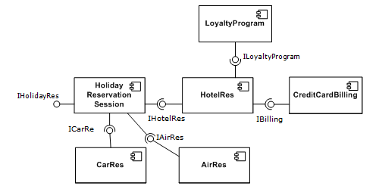
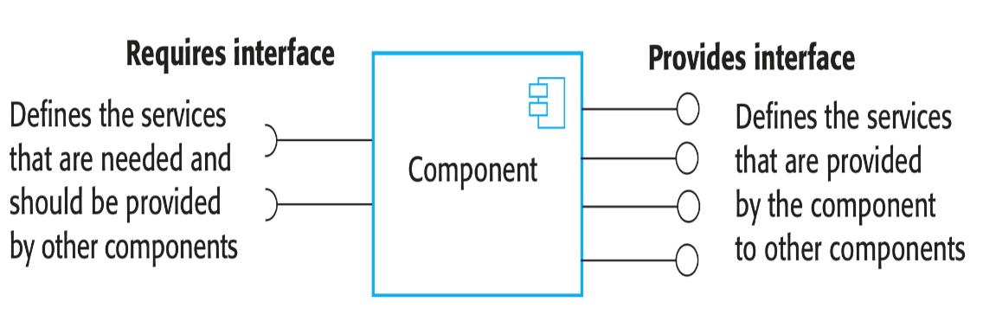
Component Interfaces cont.
Components are accessed using remote procedure calls (RPCs). Each component has a unique identifier (usually a URL) and can be referenced from any networked computer. Therefore, it can be called in a similar way as a procedure or method running on a local computer.

Slide 8
CBSE and design principles
Apart from the benefits of reuse, CBSE is based on sound software engineering design principles:
Components are independent so do not interfere with each other.
Component implementations are hidden.
Communication is through well-defined interfaces.
Component platforms are shared and reduce development costs.

Slide 9
!!! Thank You !!!

